Slide 1


Tackling
NEET
Session 1: Understanding NEEThood

Slide 2

Common Assumptions & Misconceptions:
How Young People become NEET
Not motivated – don't care, lack of effort
Fallen in with a bad crowd
Poor parenting – lack of positive role models and boundaries
Funding cuts – they can't get the help they need
Chaotic, disrupted lives
Lack of transport to get to school or college
Undiagnosed SEND
Lack of trust in authority figures
Unrealistic expectations

Slide 3
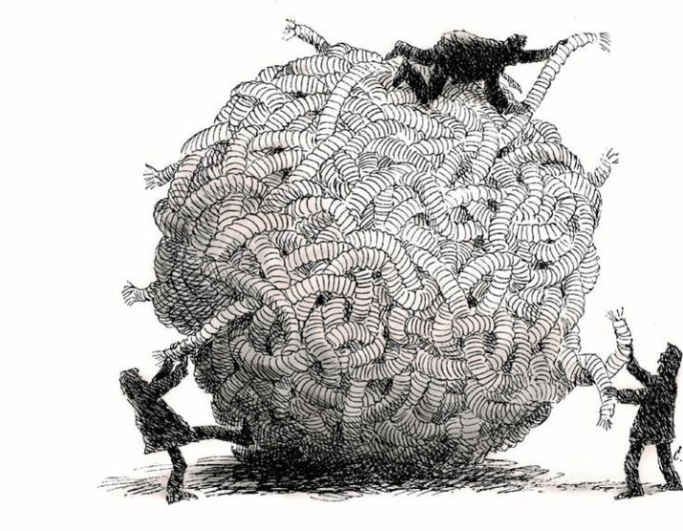
Why is it important to develop our understanding of the reasons young people become NEET?
To design support / tailor help
Meets Gatsby Benchmark 3 – Addressing the needs of each pupil
To tackle inequalities
To move beyond single-factor explanations
To support them in unpicking their unique barriers
To reduce the economic cost to public finances 2017 NEET £12-36bn

Slide 4

Somerset Statistics: Increased NEET Risk for Specific Groups
Carers 2.5 x more likely
SEND/ Health need 4 x more likely
Youth Offending Team 7.5 x more likely
In care 5.5 x more likely
Care-leavers 13 x more likely
Teenage parents 25 x more likely

Slide 5





Where Do These Findings Come From?
3.5 year EU-funded research project (Orienta4YEL)
2019-2022
Understanding and Intervening in NEET
UK study led by University of Bath
Data from South West England

Slide 6
Where Does This Information Come From?
Research Phase 1
Understanding NEET
Research Phase 2
Developing Interventions
Research Phase 3
Trialling & evaluating Interventions
Somerset and Wiltshire
Reviewing insights into risks in academic literature, project reports and policy documents across Europe
78 participants
11 Settings
2 x special school
11 Settings
3 x alternative provision
2 x virtual school
2 x charity NEET prov.
1 x LA NEET provision
1 x VET setting
110 participants

Slide 7
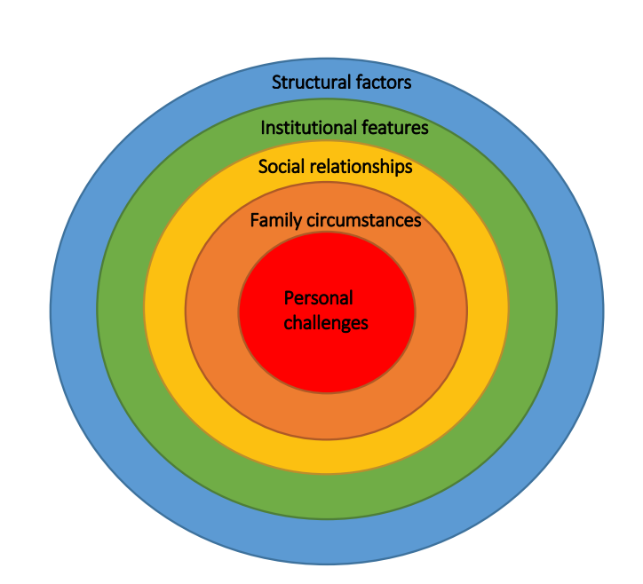
NEET: A Comprehensive Framework of Risk Factors
For further exploration of this contrast see our paper in the Journal of Youth Studies​
Notes:
See Ceri Brown, Patricia Olmos Rueda, Ioannis Costas Batlle & Joaquín Gairín Sallán (2021) Introduction to the special issue: a conceptual framework for researching the risks to early leaving, Journal of Education and Work, 34:7-8, 723-739, DOI: 10.1080/13639080.2021.2003007

Slide 8
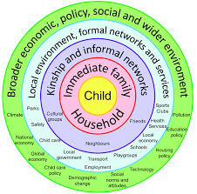
Theories Underpinning The Model
Bronfenbrenner
How child development is impacted by contextual factors
Universal Model (ie for development of all children)
Misses specific barriers for disadvantaged young people
Commonly used in Social Work, Health and Criminal Justice as well as Education

Slide 9
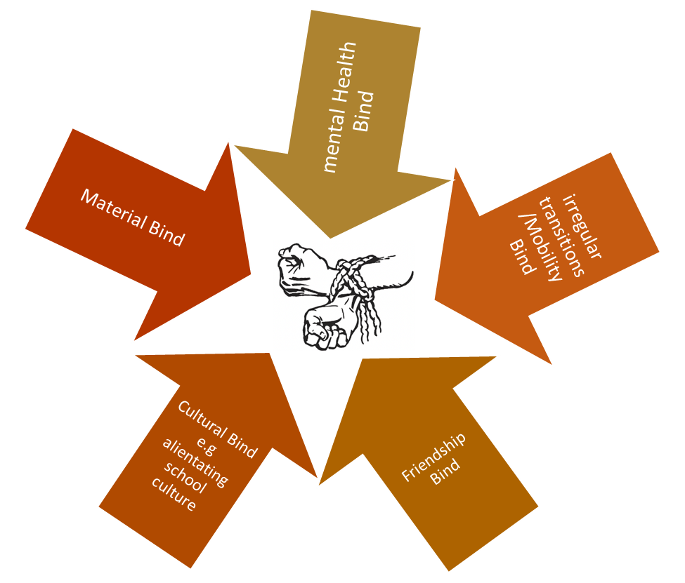
Theories Underpinning The Model
Brown
Child-centred lens, disadvantaged pupils
'Binds' – as child negotiates/wrestles barriers they constrict further, developing tensions and trade-offs
Acknowledges important role of child's agency - not passive
Highlights how children's actions mediate and shape external challenges
See this paper and this book for further discussion of the theory. Contact Ceri Brown to request copies of book chapter(s): C.L.Brown@bath.ac.uk
Notes:
Here are some notes on the resources to include on a reference slide but also perhaps linked on the notes to the ppts?
Binds of Poverty theory reference is:
Brown, C. 2014. Educational Binds of Poverty: The Lives of School Children, Abingdon: Routledge, https://www.routledge.com/Educational-Binds-of-Poverty-The-lives-of-school-children/Brown/p/book/9781138291119
Please contact author to request chapter(s): C.L.Brown@bath.ac.uk
Binds theory also discussed in conceptual paper outlining the conceptual model follow link to open access resource:
Brown, C. Olmos Rueda, P. Batlle, I.C. & Gairín Sallán, J. (2021) Introduction to the special issue: a conceptual framework for researching the risks to early leaving, Journal of Education and Work, 34:7-8, 723-739, DOI: 10.1080/13639080.2021.2003007

Slide 10

Which factors might be most/least important for your 'case' young person?
In their daily lives?
In your work with them?

Slide 11

Which factors might be most/least important for your 'case' young person?
In their daily lives?
In your work with them?

Slide 12
Which of these factors do you consider might be most/least important for the young person?
In their daily lives?
In your work with them?

Slide 13
Which of these domains do you consider might be most/least important for the young person?
Different domains may be more pressing at different points
These domains create the challenges; while there are those you see in your work with them, there are those you might not see
Understanding of the ones that aren't so visible through the course of your work may be critical to unlocking a particular barrier for a young person
Being aware of the different domains and their potential to impact upon each other can help you prioritise

Slide 14

Unpicking Risks for your 'Case'
Use the table
List up to 3 risk factors for each of the 5 categories.
Think about those that are most significant for the young person
In pairs
Discuss how the different risk categories are interrelated for your cases.
How is a risk in one category impacted by/ or impacts on risks in other categories

Slide 15
Your 'Case' Young Person
Which risk category would you target first? Why?
Coffee Break

Slide 16
You might target a particular domain for different reasons:
Young person chose it as significant
You as a professional identify that, on balance, seems most urgent
Your area of work offers you a particular route into an set of interconnected issues
Notes:
3 different reasons – yp chose it, you as professional identify it, your area of work.

Slide 17


Young People and Adults Highlight
Different Factors as being most significant
Institutional Factors
Social Relationship Factors
Structural Factors
Personal Challenges

Slide 18
Factors Stressed by Young People |  | Factors Stressed by Educators
Institutional Factors | Social Relationship Factors | Structural Factors | Personal Challenges
Rigidity and inflexibility of rules, timings and environment Behaviour management approaches Large class sizes Pressure around academic performance | Bullying Feeling different, judged and singled out Bad experiences and negative relationships with teachers Not feeling cared about Peer pressure Difficulty navigating friendships. | Requirement for post-16 maths and literacy Lack of funding and time to meet young people’s needs Non-flexible curriculum Poorly managed transitions Unclear pathways | Low self-esteem or self-confidence Mental health problems SEND Isolation Low achievement Low motivation, aspiration or expectation
For further exploration of this contrast see our paper in the Journal of Youth Studies
Notes:
See Ceri Brown, Alison Douthwaite, Ioannis Costas Batlle & Nicola Savvides (2022) A multi-stakeholder analysis of the risks to early school leaving: comparing young peoples’ and educators’ perspectives on five categories of risk, Journal of Youth Studies, DOI: 10.1080/13676261.2022.2132139

Slide 19
Discussion
Does this sound familiar? Are you surprised by any of it?
Why do you think these differences might occur?
What might this mean for your work with young people?
How do you seek young people's viewpoints on the barriers they face?
Are there further opportunities for seeking young people's perspectives on their challenges and how to overcome them?

Slide 20
How a broader understanding of risk to NEEThood can shape your work
Having the awareness to avoid one-size fits all 'explanations' for risk
Making time to get to know YPs' wider lives- shows genuine interest
Creating the space to ask young person about their barriers/challenges - as a start to a collaborative unpicking
Identifying which risk categories (and factors) are within your 'gift' and the YP's capacity to address
Ensuring adequate opportunity (in contact point and over time) to build a trusting relationship between adult and YP
Identify scope to co-opt support in other domains
Planning adequate time to develop a shared strategy for addressing risk barriers
Flexibility- in approach and mindset, to plan B, C and D...
Identifying second chance options if YP can't engage/attend – reduce pressure
Notes:
Trying not to go into the 'interventions' and 'pathway to support' stuff which will come in later sessions but to still give tips around what to avoid/ think about in general terms.
Intended here to talk about later sessions where we will go into details about what works, why it works – but this is the so-what, how might this impact what you do?
Tools to do this – we are exploring whether there are options for mapping out risks – something we're wokring on – any ideas/ imput

Slide 21
Tackling NEEThod: Training Programme
Accessing Materials Online:
Bath University NEEThood Workshops (somerset-ebp.co.uk)
Future Training:
- Interventions to tackle NEEThood
- Evaluating interventions

Slide 22

Evaluation
Thank you
Dr Alison Douthwaite and Dr Ceri Brown, Department of Education, University of Bath

