Slide 1



Singer Instruments
Singer Instruments, headquartered in Somerset on the edge of Exmoor National Park, develop laboratory automation (robots!) to accelerate research for scientists who want to make the world a better place. The following companies have Singer robots (among many others!).

Slide 2
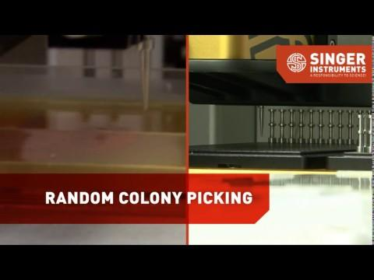
What is Laboratory automation & how does it speed up Science?
COVID-19 has made the power of biological research very clear.
Accelerating (speeding up!) biological research for healthcare (e.g.vaccines), biofuels (cleaner for the planet) & green manufacturing is growing quickly.

Slide 3


What is STEM?
STEM stands for….
Science
Technology
Engineering
Mathematics

Slide 4
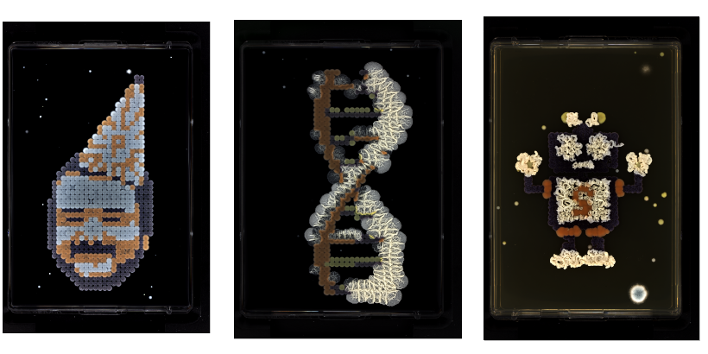
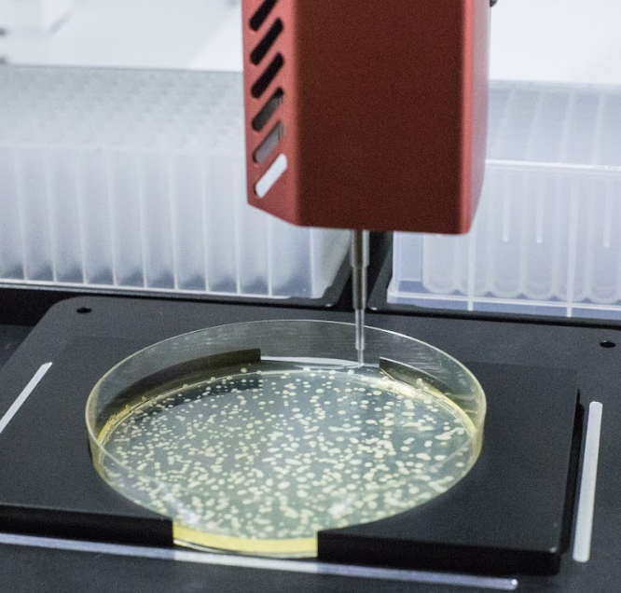
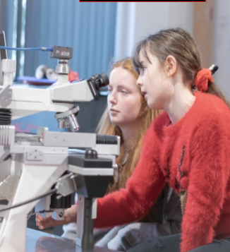
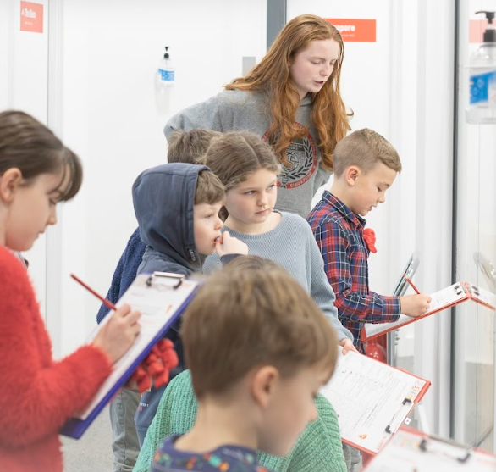
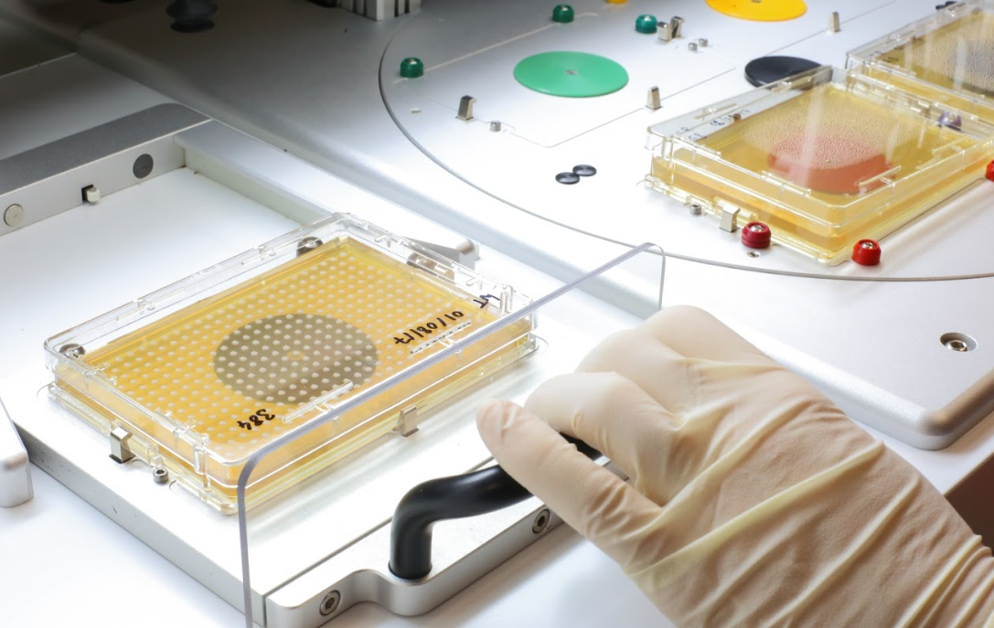
Science
BioArt
Fiona says:
My job as a Scientist isn’t just to do scientific experiments or research each day, I also help other parts of the business, such as:
Provide scientific experiment data for customers
Create some AWESOME Bioart
Improve our robots for customers
I get to work with the latest robots in lab automation every day. What could be cooler than that?
My Career path:
GCSEs: Triple Science, Maths, Food Technology
AS Level: Maths with Statistics (A)
A- Levels: Biology (A), Chemistry (B), Geography (B)
University: Biochemistry with Molecular Medicine.

Slide 5
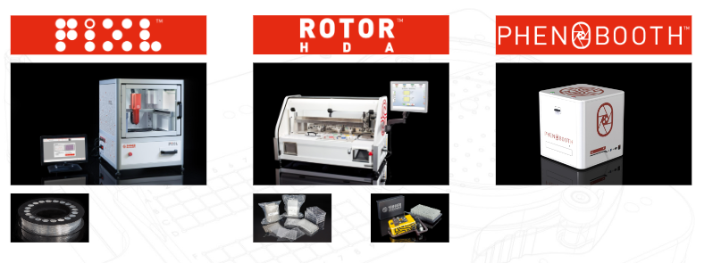
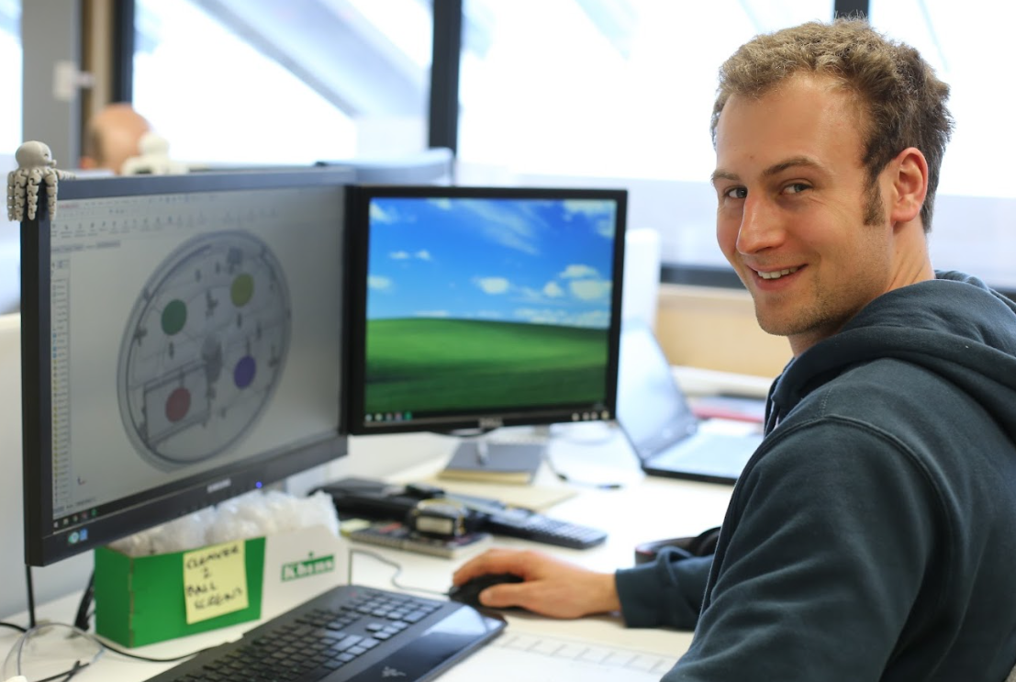
Technology
Robots are an essential part of technology
Will says:
I am the manager of the CI Team (Continuous improvement)
Our team improves our products (continuously), think of it a bit like how your Playstation or Xbox have updates!
My Career path:
GCSEs: DT, Electronics Control, IT, Business.
SCAT: Engineering.
Plymouth University: Engineering Degree
Will started at Singer Instruments as a CNC Technician and worked his way up to the role he is in now.
Notes:
Experiments:
Mostly I do colony transfer and analysis type experiments involving a variety of different organisms ensuring that everything works on our robots for what our users might do. We also do survival experiments where we grow different organisms on a variety of media (bacteria food) with/without different drugs to see what survives.
Food tech similar to lab work:
Think of it this way, when I'm cooking I follow a recipe and I use different ingredients and then I leave it in a warm place and out pops the result. I try the result and if it tastes nasty or doesn't have the right texture, I then change the recipe and repeat.Lab work is the same thing, except the recipe is an experimental method and the results aren't edible
Walk through the career path, explain how food tech is surprisingly similar to lab work.

Slide 6
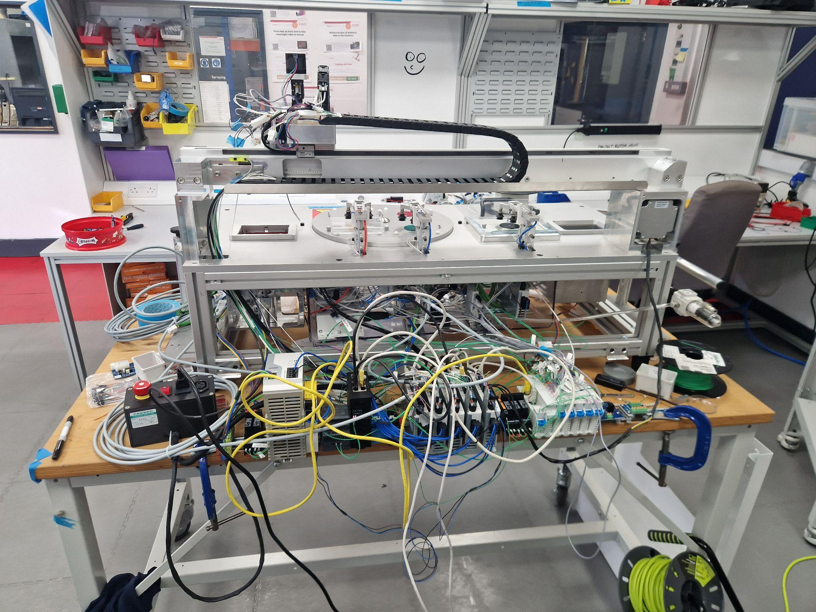
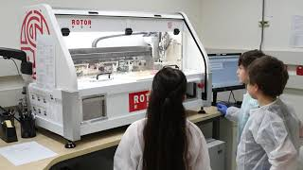
Here you can see the inner electrical workings of one of Singers robots, called the ROTOR+.
Now lets see it fully working!
Notes:
You’ve seen the inner workings of this machine, for those that are interested in engineering, this is how the final robot looks and works.

Slide 7

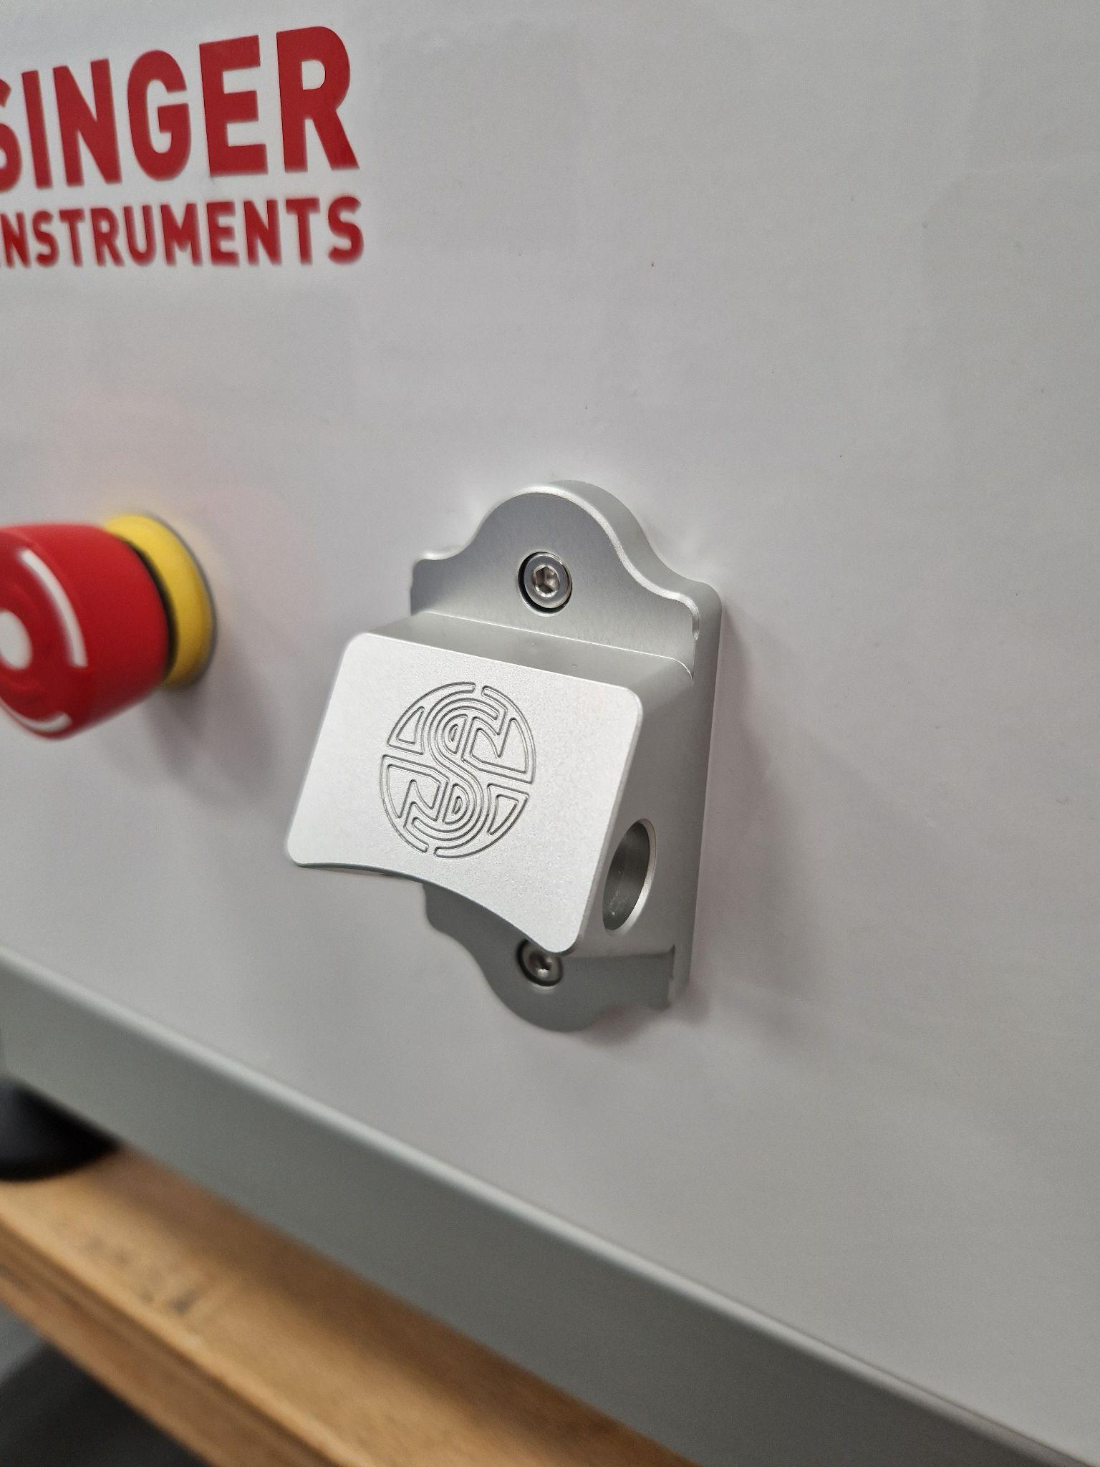
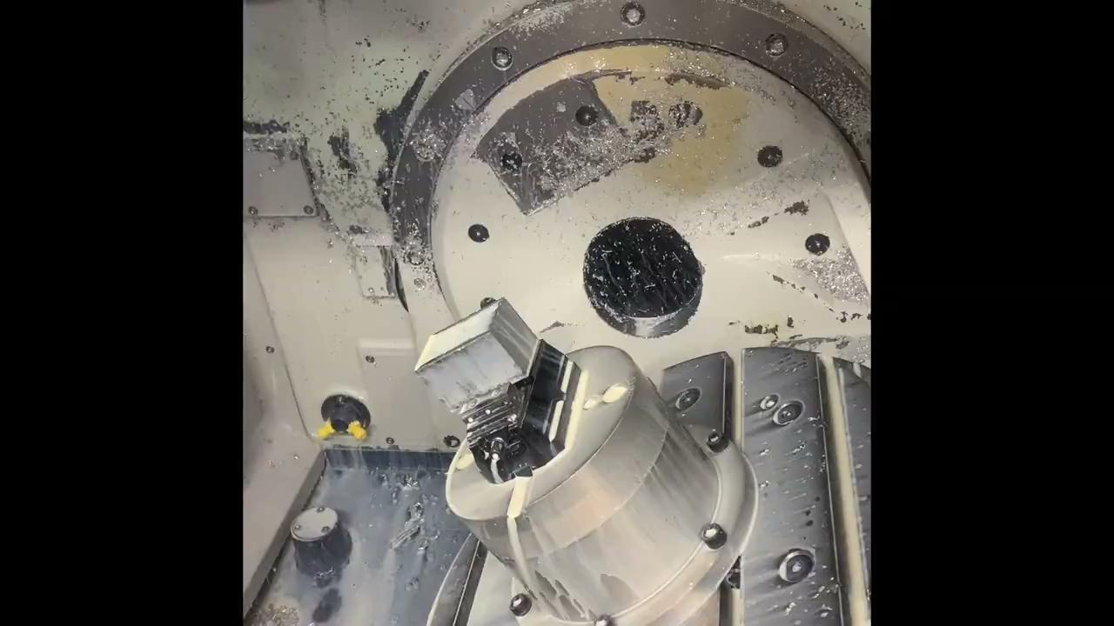
Engineering
Fun Fact: We add a bottle opener to every robot we sell.
Sam (CNC Technician) says:
My job is to program CNC Machines, to turn a block of metal or plastic into parts for the robots!
Imagine a Lego model, it is my job to make the lego bricks.
I get sent a 3D model of a part, I create a program, I send that program to the machine, then I make the actual part
My Career path:
GCSEs: Triple Science, Motor Vehicle, History & Photography.
BTEC in Manufacturing Engineering.
While doing my course I did 315 hours of work experience, which helped me get my job!
This is how we make it…

Slide 8
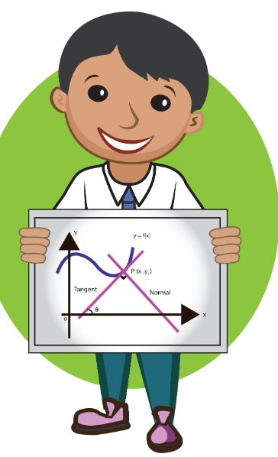

Mathematics - EVERYONE
Maths is the most important part of STEM!
Everyone who works in STEM uses maths on a daily basis.
Notes:
Experiments:
Mostly I do colony transfer and analysis type experiments involving a variety of different organisms ensuring that everything works on our robots for what our users might do. We also do survival experiments where we grow different organisms on a variety of media (bacteria food) with/without different drugs to see what survives.
Food tech similar to lab work:
Think of it this way, when I'm cooking I follow a recipe and I use different ingredients and then I leave it in a warm place and out pops the result. I try the result and if it tastes nasty or doesn't have the right texture, I then change the recipe and repeat.Lab work is the same thing, except the recipe is an experimental method and the results aren't edible
Walk through the career path, explain how food tech is surprisingly similar to lab work.

Slide 9
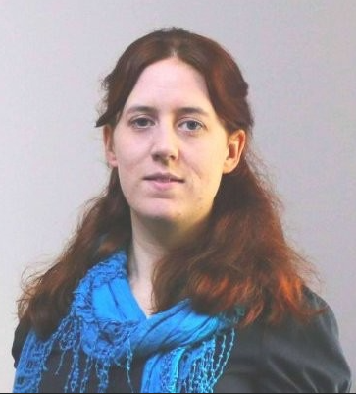
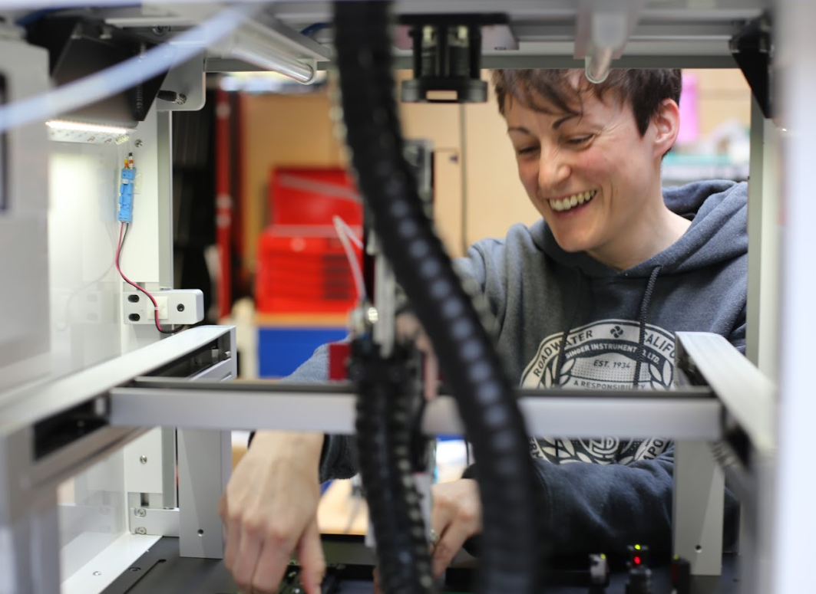
Women in Science at Singers!
At Singer Instruments we have a growing number of women working in STEM, from different backgrounds, educational routes, and parts of the world. Here are their words of advice and encouragement:
“If you know anyone wanting to enter the World of STEM I'd tell them to just go for it! Don't put too much pressure to pick exactly which area you want to work in early on as you can always change your mind, there are always opportunities where you may not traditionally realise them”
Claire, Product Manager
“I love living in West Somerset but it can be very limiting on career direction and this helped push me towards Singers and STEM, and I am really glad it did”
Jo, Assembly Technician

Slide 10

Women in Science at Singers!
“90% of my colleagues are men and women are less willing to study mechanical engineering….. If you are interested in it, it will be enjoyable…. If you enjoy creating and challenging, you will also enjoy engineering”
Farzaneh, Mechanical Engineer

